Slide 1

Presentation By : Bhavya Batra
Committee Members : Dr. Susan Mengel (Chair)
Dr. Sepideh Ghanavati
Dr. Richard Watson
April 28th, 2017

Slide 2
The Blueprint
Introduction: SWE Origin
Introduction: SWE Operations
Introduction: SWE – OAWP
SWE-OAWP: Activity Diagram
SWE-OAWP: Design
SWE-OAWP: Architecture
SWE-OAWP: Class Diagram
SWE-OAWP: Use-Case Diagram
SWE-OAWP: Sequence Diagram
SWE-OAWP: Operation
SWE-OAWP: Testing
SWE-OAWP: What’s in the Future ?
SWE-OAWP: Related Works
SWE-OAWP: Now, Lets go Live !!

Slide 3
Introduction: The Beginning

Slide 4
Introduction: SWE-Operations

Slide 5
Introduction: SWE-OAWP

Slide 6



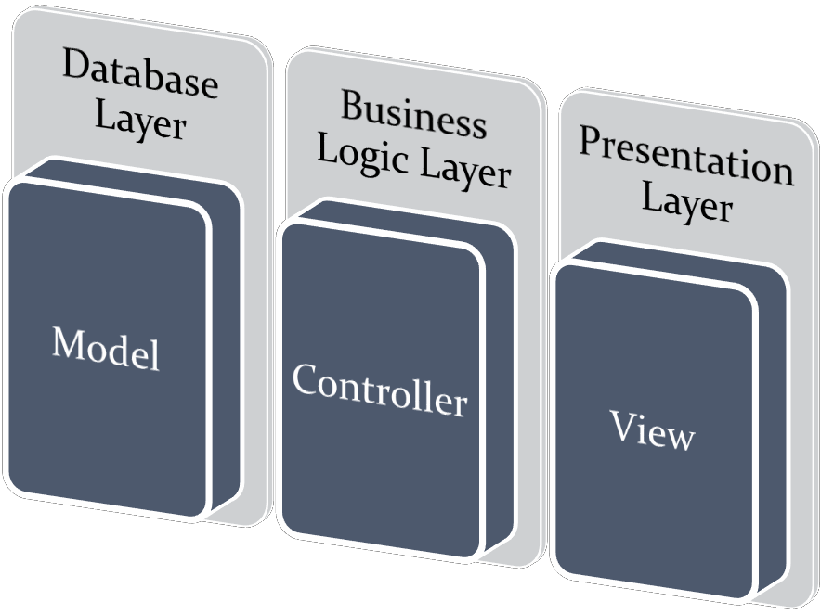
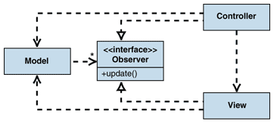
SWE-OAWP : The Design

Slide 7
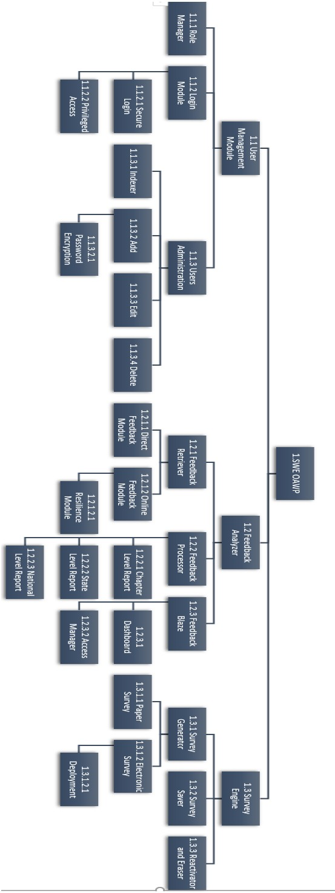
SWE-OAWP : Architecture

Slide 8
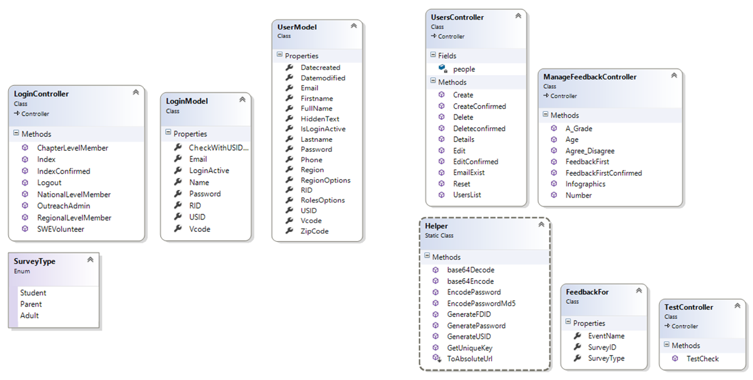
SWE-OAWP : Class-Diagram

Slide 9
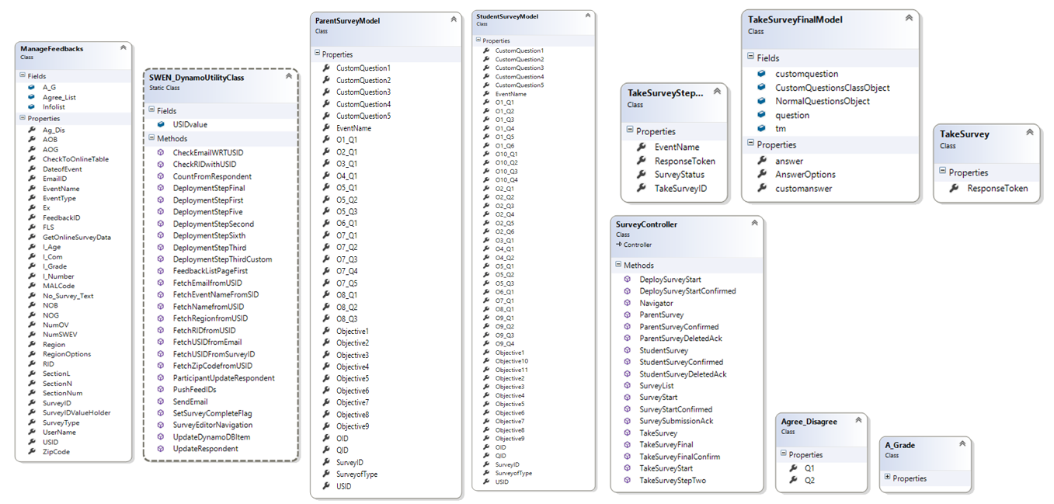
SWE-OAWP : Class-Diagram

Slide 10
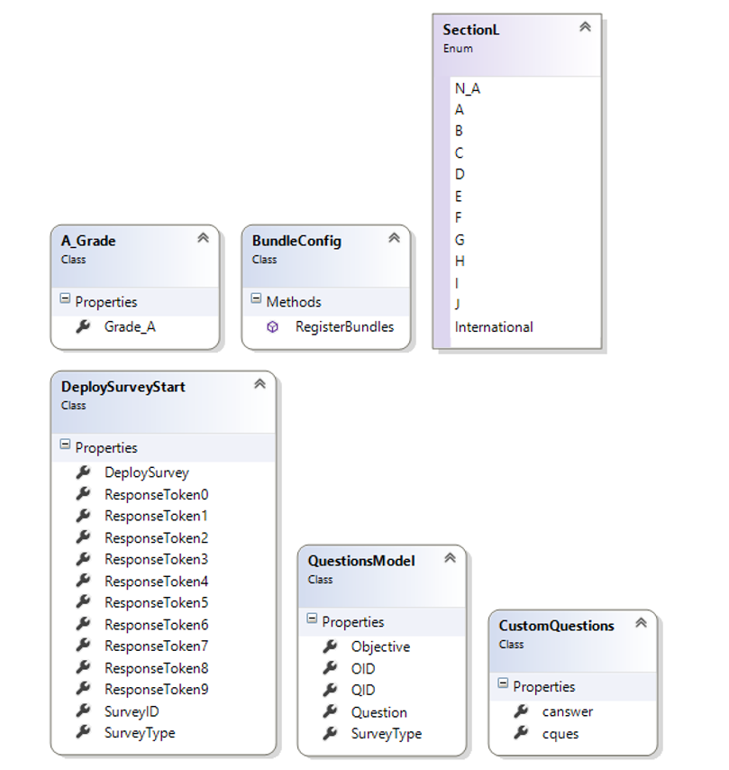
SWE-OAWP : Class-Diagram

Slide 11
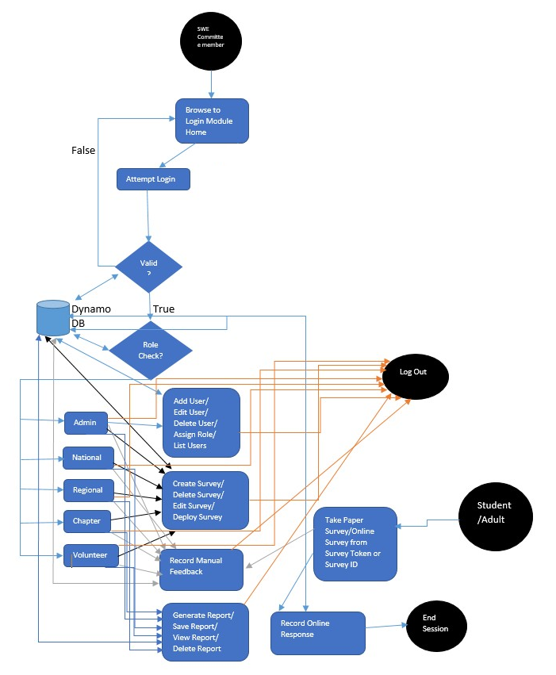
SWE-OAWP : Activity Diagram

Slide 12
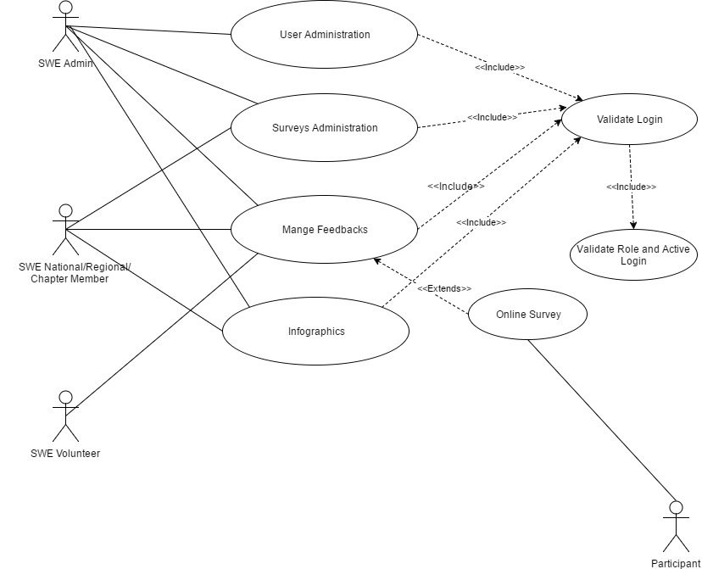
SWE-OAWP : Use-Case Diagram

Slide 13
SWE-OAWP : In-Operation

Slide 14
SWE-OAWP : Testing
#Number | Tester Name | Assigned Role | Department
1 | Vinay Deshpande | Outreach Admin | Computer Science
2 | Manohar Kotapati | National Level Admin | Computer Science
3 | Vibhuti Gupta | National Level Admin | Computer Science
4 | Abdullah Ejaz | Regional Level Admin | Computer Science
5 | Phani Cherukuri | Regional Level Admin | Computer Science
6 | Vidya Eswarappa | Chapter Level Admin | Computer Science
7 | Anjikya Tiwari | Chapter Level Admin | Computer Science
8 | Jose Salazar | SWE Volunteer | Law
9 | Gaurav Vinayaka | SWE Volunteer | Computer Science
10 | Mayuresh Indapurkar | SWE Volunteer | Data Science
11 | Tania Singh | Participant | Law
12 | Sara Khan | Participant | Law
13 | Arun Jegarkal | Participant | Computer Science
14 | Vinay Deshpande | Participant | Computer Science
15 | Bhavya Batra | Participant | Computer Science-SE

Slide 15
The Blueprint

Slide 16
The Blueprint

Slide 17
The Blueprint

Slide 18
The Blueprint

Slide 19
The Blueprint

Slide 20
The Blueprint

Slide 21
The Blueprint

Slide 22
The Blueprint

Slide 23
The Blueprint

Slide 24
The Blueprint

Slide 25
The Blueprint

Slide 26
The Blueprint

Slide 27
The Blueprint

Slide 28
The Blueprint

Slide 29
The Blueprint

Slide 30
The Blueprint

Slide 31
The Blueprint

